Slide 1
CIAM Project Updates
01st October 2024

Slide 2
Agenda
Project Status & Milestones
Current/Latest Progress Summary (Last 2 Weeks)
Summary of the CIAM Data Points for BI Reporting
Ongoing Data/Business Logic Validation – Summary & Risks
Dashboard Wireframe Profile & Activity View
1
2
3
4
5

Slide 3
Project Status & Milestones – Data Engineering Track
Data Engineering |  | Progress | Risk Level | Complete Week | Dependencies & Challenges
Activity 1 – Create Fact Tables in Athena [Test/Sample]
 | |__ Account Fact Table & Profile Fact Table |  |  | WE 9th September | Correct Filtering of Data & Field Level Data Validation
 | |__Transaction Fact Octa Table & Transaction Fact Adobe Table |  |  | WE 16th September
Activity 2 – Upload Fact Tables in S3 - CIAM_DATAMODEL [Test files]
 | |__ Upload Fact Tables to S3 Bucket Storage |  |  | WE 23rd September | Data Transformation & Validation using AWS Quicksights
 | |__ Validation and Transformation of Activity Fact Tables |  |  | Ongoing
Create Partition & Load - External Table in AWS Athena
 | |__ Loading Incremental Data into the External Tables |  |  | WE 25th October | Access may take upto 2-3 weeks may delay these activities
 | |__ Complete data update in all Fact Tables |  |  | WE 25th October
Create Data ETL Pipeline in AWS Glue
 | |__ Create IAM Role for AWS Glue |  |  | WE 29st November | Dependency on Previous Tasks, AWS Glue Access may delay the Timelines
 | |__ AWS Glue Crawler for Data Schema & Metadata Tables |  |  | WE 29st November
Data & Pipeline Testing & Production Deployment |  |  |  | WE 6st December | TBD
Complete
Low
Complete
Low
Complete
Low
WIP
Low
Not started
High
Not started
High
Not started
High
Not started
High
Not started
Medium

Slide 4
Project Status & Milestones – BI & Reporting
Data Engineering |  | Progress | Risk Level | Complete Week | Dependencies & Challenges
Activity 1 –Wire Frame/Mock up Design for the Problem Statement
 | |__ Design Mock up Wireframe for Business Agreement |  |  | WE 16th September | Design Validation & Agreement on the Final Wireframe
 | |__Iterative on the Agreed Design and Functionality |  |  | WE 23rd September
Activity 2 – Map/validate Columns to the Data Model (Fact Tables)
 | |__ Upload Account Fact Table & Profile Fact Table |  |  | WE 18th October | Data Mapping/Validation to Design Wireframe & Transformation Assessment
 | |__ Transaction Fact Octa Table & Transaction Fact Adobe Table |  |  | WE 18th October
Demo & Iterate on the Agreed Design with Actual Data on Tableau
 | |__ Integrate with Data Ingestion through ETL Pieplines |  |  | WE 15st November | Tableau & ETL Implementation & Completion by the Data Team
 | |__ Data Tarnsformation & Design/Report Validation |  |  | WE 15st November
Dashboards Development & Getting Ready for Production
 | |__ Creation of Profile & Activity Dashboards |  |  | WE 29th November | Previous Tasks and Validation & Sign off by the Business Teams
 | |__ Testing of the Dashboards by Dev Team & Production SMEs |  |  | WE 29th November
Dashboards Production Deployment & Training |  |  |  | WE 6th December | TBD
Complete
Low
Complete
Low
WIP
Low
WIP
Low
Not started
High
Not started
High
Not started
High
Not started
High
Not started
Medium

Slide 5



Current/Latest Progress Summary (Last 2 Weeks)
Ongoing Activities
WIP Progress Updates
Challenges, Risks & Questions
Tables Data Validation
Ongoing Verification of field level data against defined rules/criteria
Identify errors or inconsistencies and determine how to handle them
Share findings with the organization for review & alignment
Document the validation process and results for Next stage of ETL
Data validation is manual leveraging SQL in AWS Athena
Limited access to all CIAM DB in AICOE Sandbox
Limited access to the MS Excel for Validation
Awaited access to AWS Insights for Validation
Data Mapping to BI Report
Mapping of columns or values of the data from the fact tables create and uploaded in Sandbox
Validate the Filed Level Format/Transformation Assessment & Best-Fit Feasibility at Data/BI Layer
Determining the Data Ingestion & Automation Workflow Rules
Limited access to the MS Excel for Validation
Awaited access to AWS Insights for Mapping & Transformation Assessment
Awaited access for Tableau BI Solution
BI Design/Wireframe
Iterating on the Dashboard Wireframe based on Business Feedback
Contextualizing the Wireframe Based on the Data Mapping Findings
Ongoing Alignment on Finalizing the Wireframe with Actual Data
Awaited access to AWS Insights for Mapping & Transformation Assessment
Awaited access for Tableau BI Solution

Slide 6
Summary of the CIAM Data Points for BI
Update COX Details from Data Model– Shital & Sharmila
Review – Shree/Harry/Vikas
Sources | Total Contacts | Engagement | Contacts % | Indirect | Direct
Windows Registration | 1658377 | High | 32% | 99% | 1%
 |  | Medium | 10% | 99% | 1%
 |  | Low | 58% | 100% | 0%
SAP Shipment | 107974 | High | 38% | 0% | 100%
 |  | Medium | 14% | 0% | 100%
 |  | Low | 48% | 0% | 100%
Hybris Registration | 95098 | High | 47% | 7% | 93%
 |  | Medium | 20% | 6% | 94%
 |  | Low | 33% | 8% | 92%
Comaps Registration | 25157 | High | 46% | 4% | 96%
 |  | Medium | 21% | 3% | 97%
 |  | Low | 33% | 5% | 95%
Adobe Target | 16351 | High | 59% | 21% | 79%
 |  | Medium | 29% | 25% | 75%
 |  | Low | 11% | 46% | 54%
Hybris Order | 14430 | High | 45% | 1% | 99%
 |  | Medium | 14% | 1% | 99%
 |  | Low | 42% | 1% | 99%
Android Registration | 11835 | High | 15% | 99% | 1%
 |  | Medium | 10% | 100% | 0%
 |  | Low | 75% | 100% | 0%
Netmining | 11644 | High | 55% | 25% | 75%
 |  | Medium | 33% | 23% | 77%
 |  | Low | 13% | 47% | 53%
Crowds Loyalty | 11306 | High | 52% | 4% | 96%
 |  | Medium | 21% | 6% | 94%
 |  | Low | 27% | 6% | 94%
Lenovo.com Email Signup | 3116 | High | 65% | 21% | 79%
 |  | Medium | 26% | 24% | 76%
 |  | Low | 9% | 40% | 60%
Observations Questions & Data Challenges
XYZ
ABC
Etc.
Sample – Customize for CIAM Data

Slide 7
Ongoing Data/Business Logic Validation – Summary & Risks
The Data Engg and BI Teams is consistently working with support from the Cox Teams to continuously enhance the KPIs and the associated data inconsistencies or business logic which is consuming additional time/efforts for the data models and one such recent example is below
Ongoing Activities | Account Fact Table | Profile Fact Table | Transaction Adobe Fact Table | Transaction Octa Fact Table (User Level) | Transaction Octa Fact Table (Day Level)
Fetched Records | 184,286 | 235,594 | 161,144 | 227,873 | 1,540,022
Business Logic Validation | Ongoing | Ongoing | Ongoing | Ongoing | Ongoing
Handling Data Inconsistencies | Ongoing | Ongoing | Ongoing | Ongoing | Ongoing
Data Inconsistencies & Validation Examples
For some customers we are getting multiple registration dates which should be not the case so we resolved using the earliest registration date
In profile_fact tables we have data inconsistency on primary_user_flag. Logically, we should have one customer has only one primary_flag=“Y” but we are getting two primary flag as Y
For some tables, the columns/attributes are missing for the calculated columns and the business logic for the same needs to be validated
Changes to the business logic as above leads to rework from the team for data retrieval, validation and alignment

Slide 8
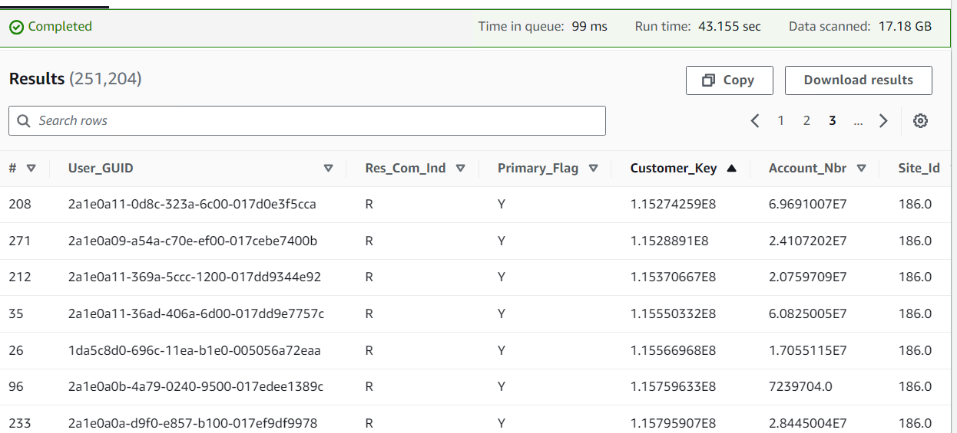
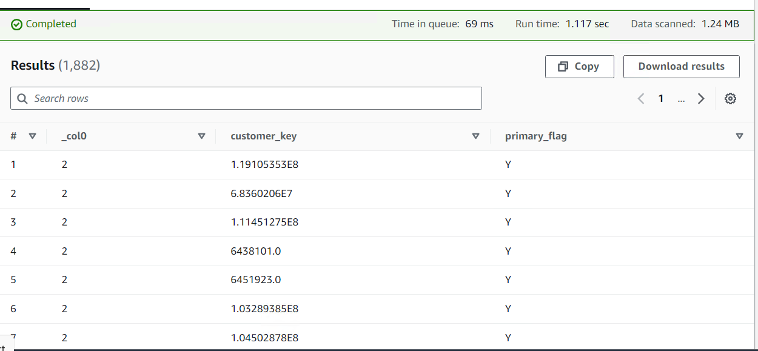
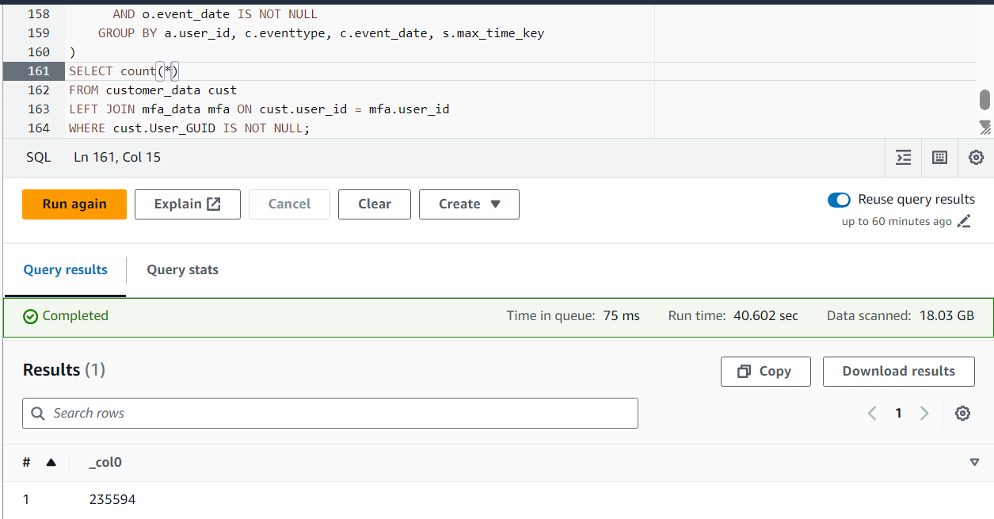
Ongoing Data/Business Logic – Observations & Challenges
The Data Engg and BI Teams is consistently working with support from the Cox Teams to continuously enhance the KPIs and the associated data inconsistencies or business logic which is consuming additional time/efforts for the data models and one such recent example is below
In profile_fact tables we have data inconsistency on primary_user_flag. Logically, we should have one customer has only one primary_flag=“Y” but we are getting two primary flag as Y
Therefore, we are getting count as 251,204 in profile dim where customer who has more than one primary flag has 1,882 records
If we take only one primary_flag=y for one customer then we are getting 235594 records.

Slide 9
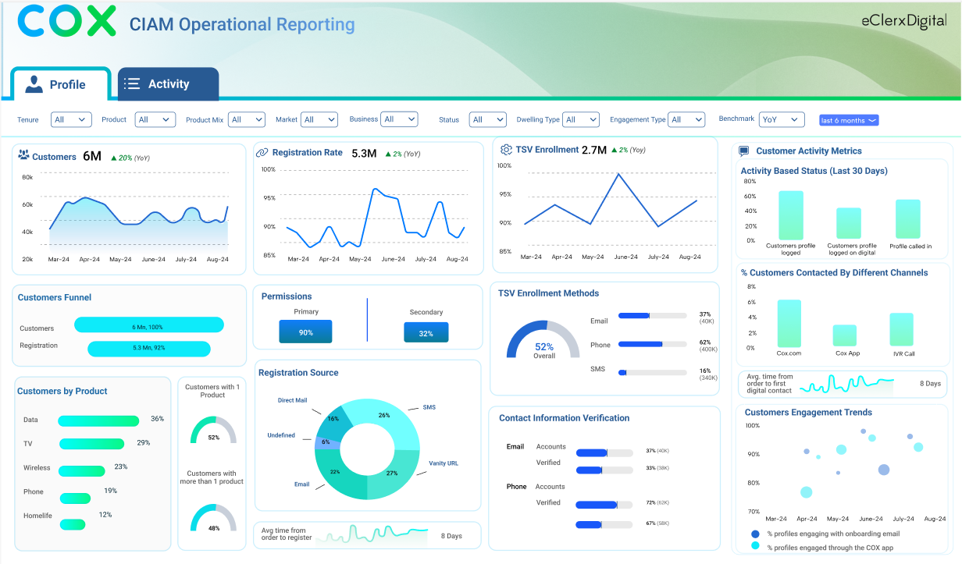
Dashboard Wireframe – Profile & Activity View

Slide 10
Thank You

Slide 11
Original Project Plan
Activities |  | 12-Aug | 19-Aug | 26-Aug | 2-Sep | 9-Sep | 16-Sep | 23-Sep | 30-Sep | 7-Oct | 14-Oct | 21-Oct | 28-Oct | 4-Nov
Engineering | Individual Accesses & Azure AVD set up
 | Discovery & Requirement Gathering
 | Accesses and Environment Setup (AWS)
 | Build Data Framework
 | Data Validation
 | Data Transformation Flow (ETL)
 | Scheduling and Automation
 | Monitoring
Visualization | Business Goals & Data Sample
 | Design Templates
 | Stakeholder Review
 | Development
 | Validation
 | Stakeholder Review
 | Deployment & Support

Slide 12
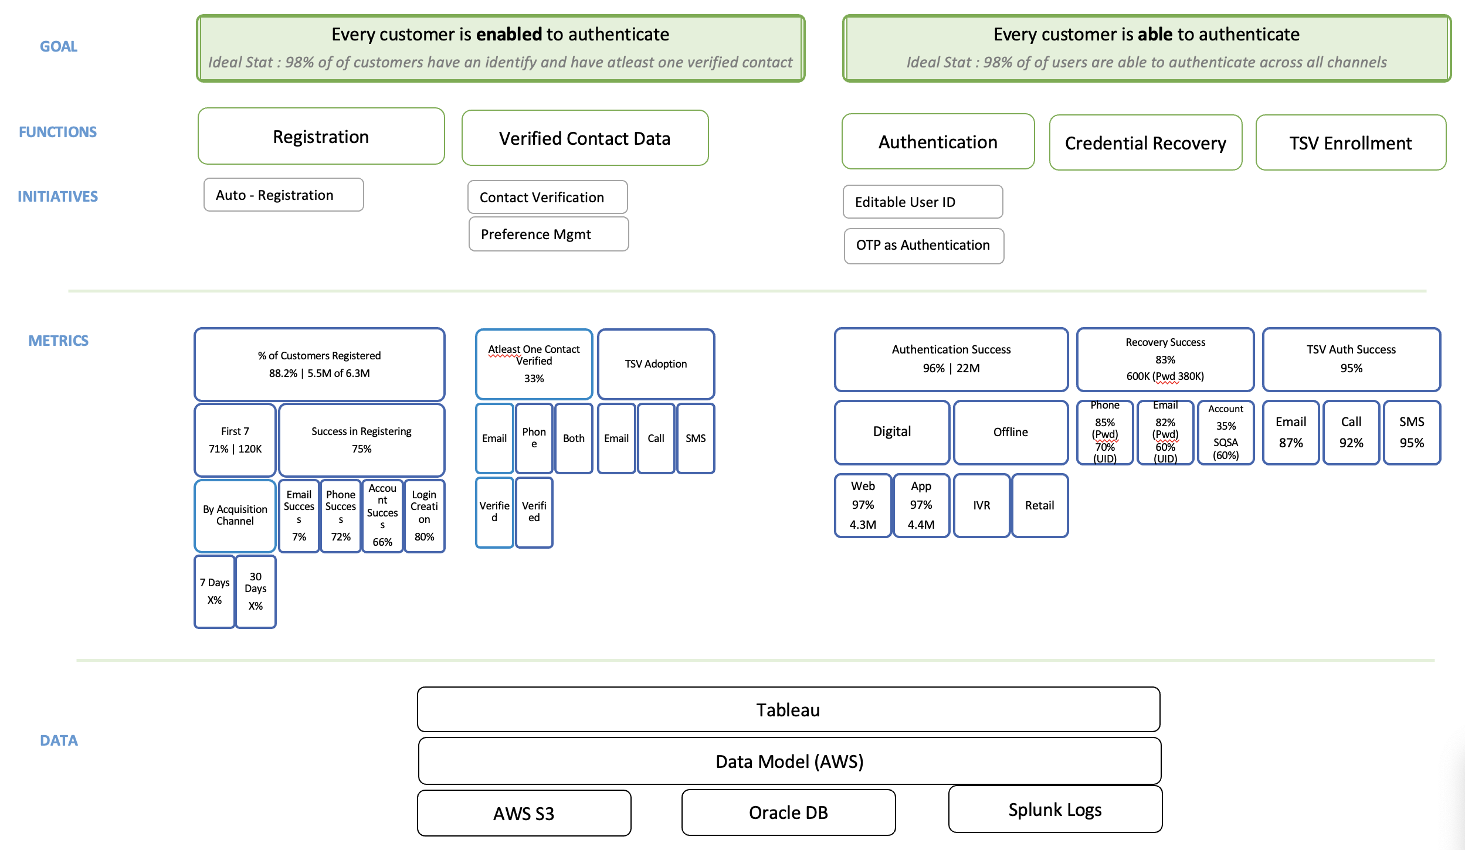
CIAM - Functions, Initiatives and Metrics Mapping (Original)

